Slide 1
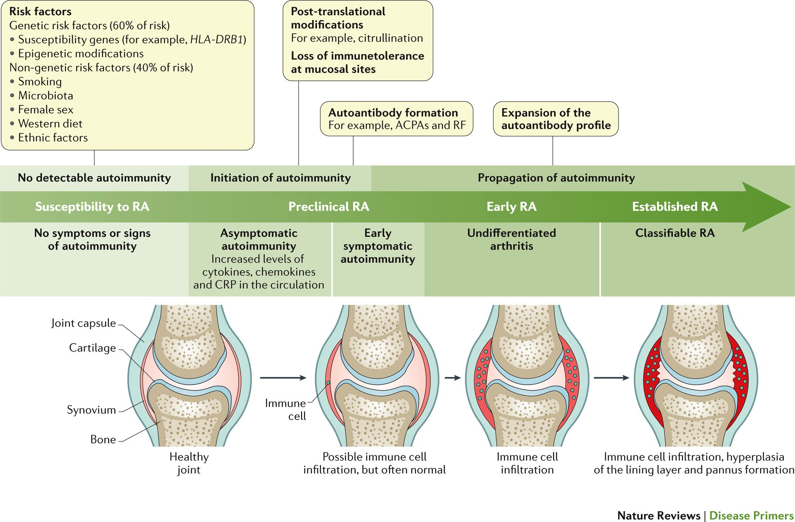

Slide 2
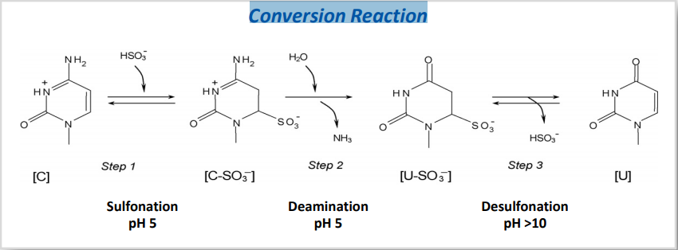
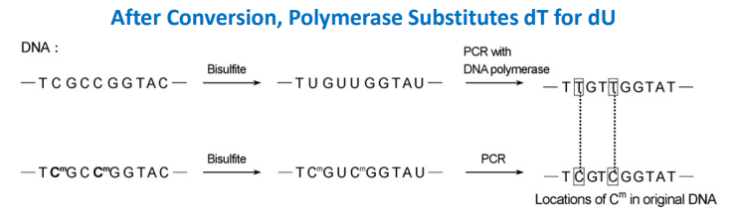
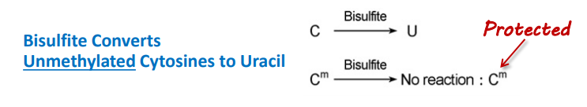
• Converts non-methylated cytosines to uracil
• 5-methylcytosine (5mC) & 5-hydroxymethylcytosine (5hmC) are resistant

Slide 3
Association Study based Meta Analysis to Rheumatoid Arthritis
ID | SNP | Chromosome | Position | Overlapped Gene | Type | Annotation
chr5:143399010:G/C:1 | rs41423247 | chr5 | 143399010 | NR3C1 | protein_coding | intronic,3downstream
chr20:46118343:T/C:1 | rs1883832 | chr20 | 46118343 | CD40 | protein_coding | 5utr,5upstream
chr21:44289270:G/A:1 | rs2075876 | chr21 | 44289270 | AIRE | protein_coding | intronic,5upstream,non-coding
chr4:101829765:T/C:1 | rs17266594 | chr4 | 101829765 | BANK1 | protein_coding | intronic
chr6:52236941:T/C:1 | rs763780 | chr6 | 52236941 | IL17F | protein_coding | coding nonsyn,non-coding
chrX:154010439:C/A:1 | rs3027898 | chrX | 154010439 | TMEM187
chr10:43492825:C/T:1 | rs3122227 | chr10 | 43492825 | ZNF487
chr8:11486464:C/T:1 | rs2736340 | chr8 | 11486464 | FAM167A
chr1:113834946:A/G:1 | rs2476601 | chr1 | 113834946 | PTPN22 | protein_coding | coding nonsyn,intronic,non-coding,3utr
chr1:172658358:C/T:1 | rs763110 | chr1 | 172658358 | FASLG
chr16:31265490:G/A:1 | rs1143679 | chr16 | 31265490 | ITGAM | protein_coding | coding nonsyn
chr7:128938247:T/G:1 | rs2004640 | chr7 | 128938247 | IRF5 | protein_coding | intronic,non-coding intronic,5upstream
chr5:160485411:C/G:1 | rs2910164 | chr5 | 160485411 | MIR3142HG | lincRNA | non-coding
chr5:160485411:C/G:1 | rs2910164 | chr5 | 160485411 | MIR146A | miRNA | non-coding
chr2:162267541:C/T:1 | rs1990760 | chr2 | 162267541 | IFIH1 | protein_coding | coding nonsyn
chr2:191099907:T/G:1 | rs7574865 | chr2 | 191099907 | STAT4 | protein_coding | intronic,non-coding intronic
chr3:52227015:A/G:1 | rs187084 | chr3 | 52227015 | AC097637.1 | protein_coding | intronic
chr11:112164735:T/G:1 | rs1946518 | chr11 | 112164735 | SDHD | protein_coding | non-coding intronic,intronic
chr2:203745673:C/T:1 | rs1980422 | chr2 | 203745673 | FASLG
chr18:69864406:T/A/C:1 | rs763361 | chr18 | 69864406 | CD226 | protein_coding | coding nonsyn|nonsyn,intronic
chr1:67222666:T/C:1 | rs10489629 | chr1 | 67222666 | C1orf141 | protein_coding | intronic
chr1:67222666:T/C:1 | rs10489629 | chr1 | 67222666 | IL23R | protein_coding | intronic
chr13:73918865:G/A:1 | rs1887346 | chr13 | 73918865 | KLF12 | protein_coding | intronic,non-coding intronic
chr11:118741072:G/A:1 | rs10892279 | chr11 | 118741072 | AP002954.1 | antisense_RNA | non-coding intronic
Association between PADI4 and rheumatoid arthritis: a meta-analysis. Rheumatology (Oxford). 2006 Jul;45(7):804-7. Epub 2006 Jan 31.

Slide 4
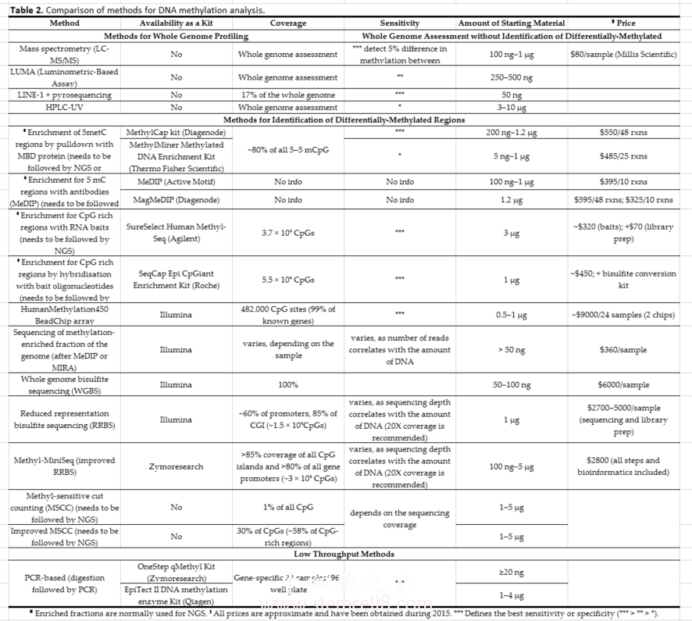

Slide 5
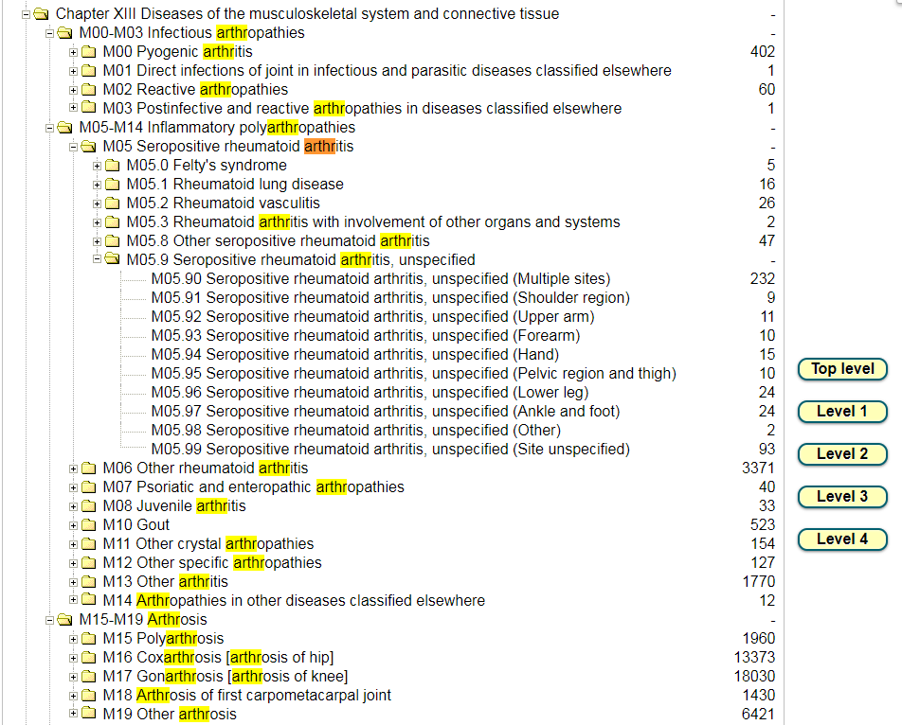
UK-Biobank Rheumatoid Arthritis ICD-10 Structure

Slide 6
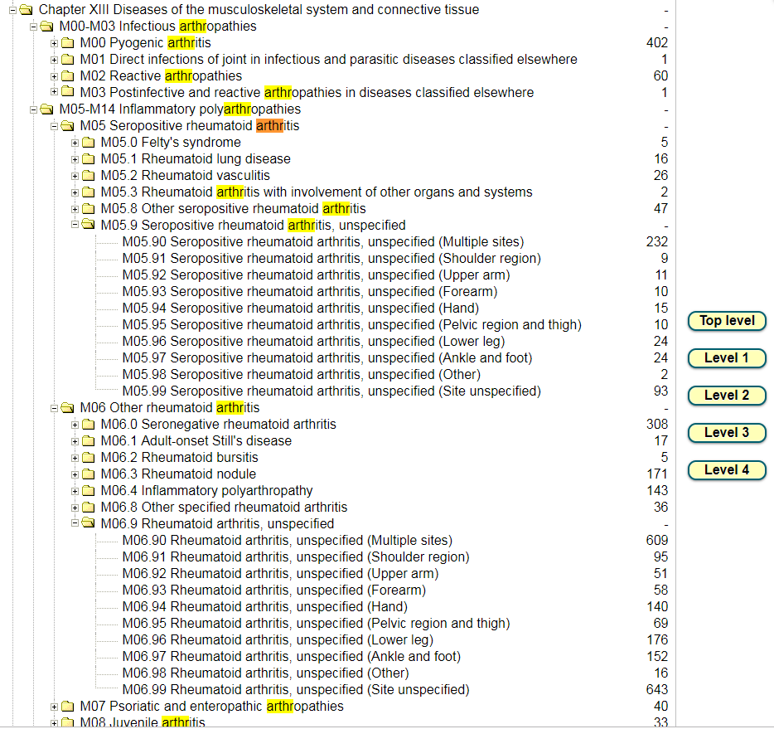
UK-Biobank Rheumatoid Arthritis ICD-10 Structure

Slide 7
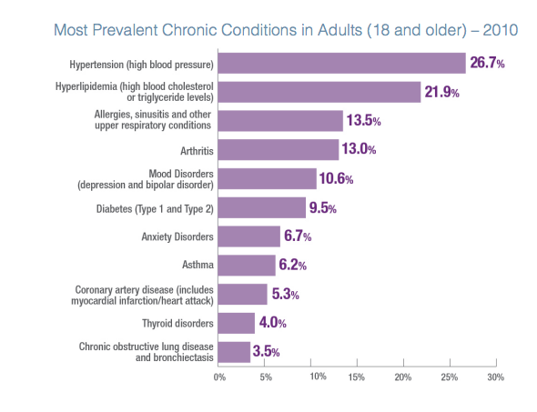
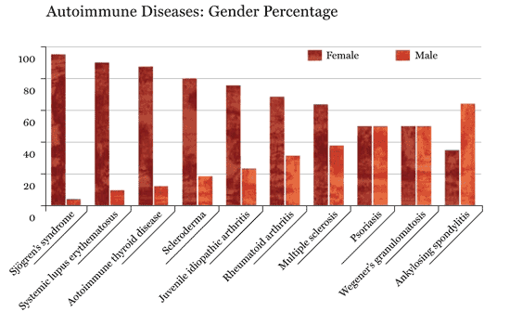
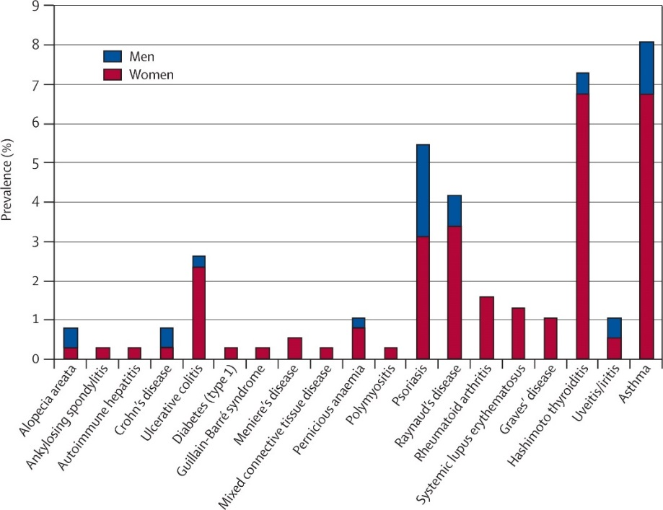
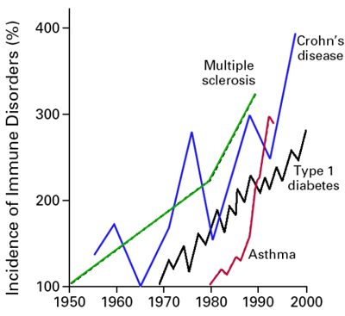
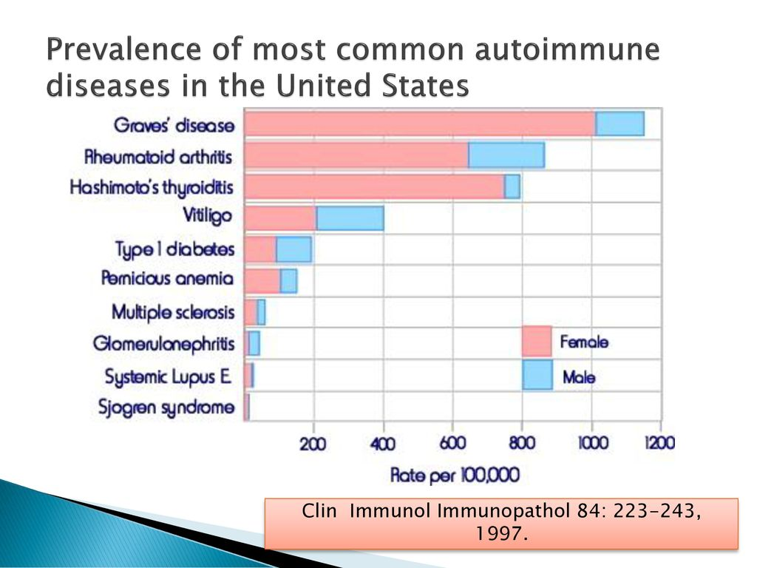
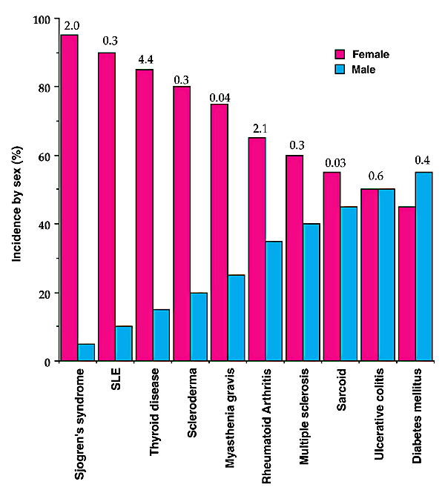
Prevalence of Autoimmune Diseases

Slide 8



Slide 9
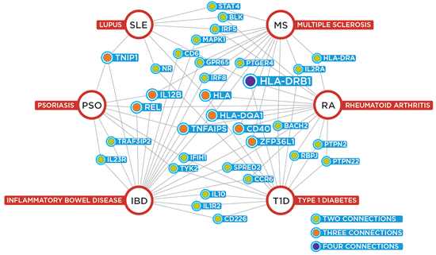

Slide 10
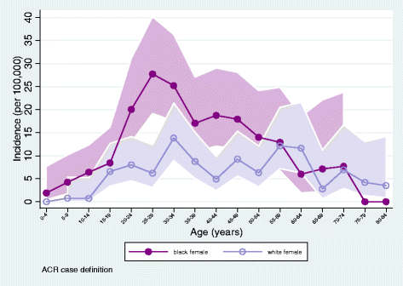
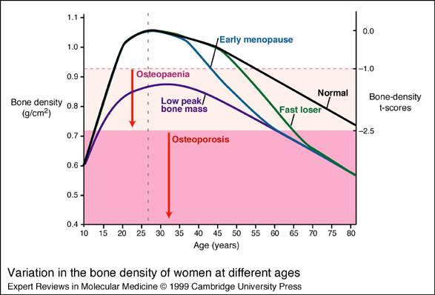
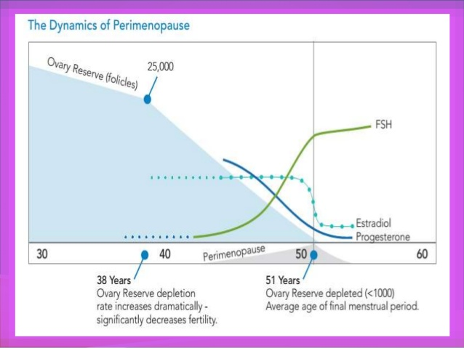

Slide 11
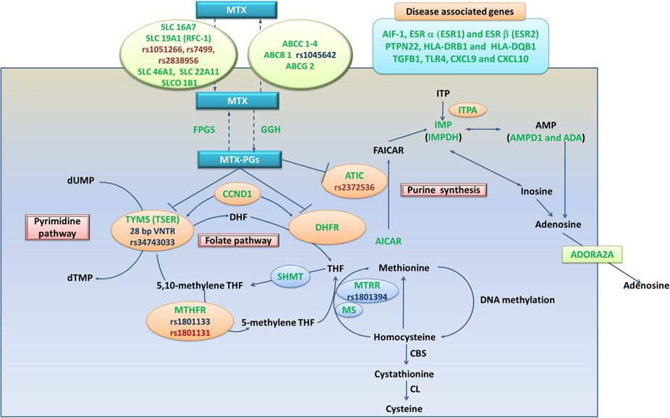
Figure 3 : Summary of detected gene polymorphisms associated with the MTX response in RA patients in previous studies.
Notes:
Schematic representation of the intracellular folate biosynthetic pathway and the gene polymorphisms detected in previous studies (in green), the polymorphisms included in the present meta-analysis were highlighted in red or blue, and the SNPs in red showed associations with the MTX effectiveness in RA patients. MTX: Methotrexate; MTX-PGs: Methotrexate polyglutamates; Transport system: SLC16A7, SLC19A1, SLC46A1 and SLC22A11: Solute carriers; SLCO 1B1: Solute carrier organic anion transporter; RFC-1: Reduced folate carrier 1; ABCC1–4, ABCB1 and ABCG2: Adenosine triphosphate–binding cassette (ABC) transporters. Enzymes: ADA: Adenosine deaminase; ATIC: -Aminoimidazole-4-carboxamide ribonucleotide transformylase/IMP cyclohydrolase; IMP: Inosine monophosphate; IMPDH2: Inosine 5′-monophosphate dehydrogenase; CBS: Cystathionine-β-synthase; CL: Cystathionine lyase; DHFR: Dihydrofolate reductase; FPGS: Folylpolyglutamyl synthase; GGH: Glutamyl hydrolase; CCND1: Cyclin D1; MS: Methionine synthase; MTHFR: Methylenetetrahydrofolate reductase; MTHFD1: Methylenetetrahydrofolate dehydrogenase; MTRR: Methionine synthase reductase; SHMT: Serine hydroxymethyltransferase; TYMS: thymidylate; TSER: Thymidylate synthase enhancer region. Metabolites: ADP: Adenosine diphosphate; AICAR: 5-aminoimidazole-4-carboxamide ribonucleotide; AMP: Adenosine monophosphate; ATP: Adenosine triphosphate; CH3: Methyl group; DHF: Dihydrofolate; dTMP: Deoxythymidine-5′-monophosphate; dUMP: Deoxyuridine-5′-monophosphate; FAICAR: 10-formyl-AICAR; ITP: Inosine triphosphate; ITPA: Inosine triphosphate pyrophosphatase; THF: tetrahydrofolate. Disease associated gene polymorphisms: ESR: Estrogen receptors; AIF-1: Allograft inflammatory factor-1; PTPN2: Protein tyrosine phosphatase non-receptor type 22; HLA: Human leukocyte antigen; TLR4: Toll-like receptor 4; CXC: Chemokines; TGFB: tissue growth factor β.

Slide 12
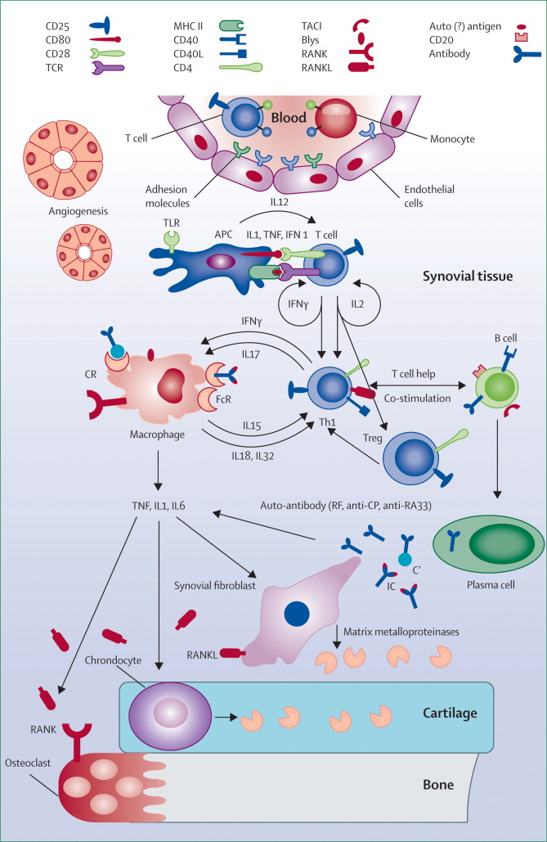
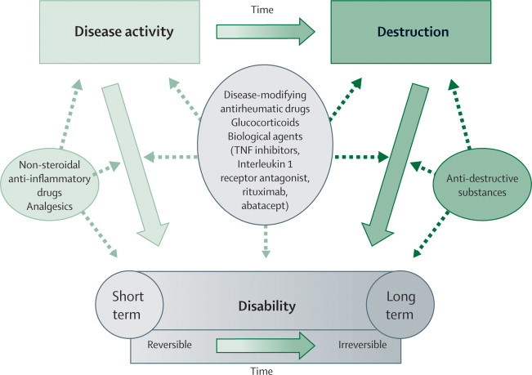
Figure 2Inter-relationship between disease activity, joint damage, and reversible or irreversible functional limitation, and differences in effectiveness of various therapeutic principles

Slide 13
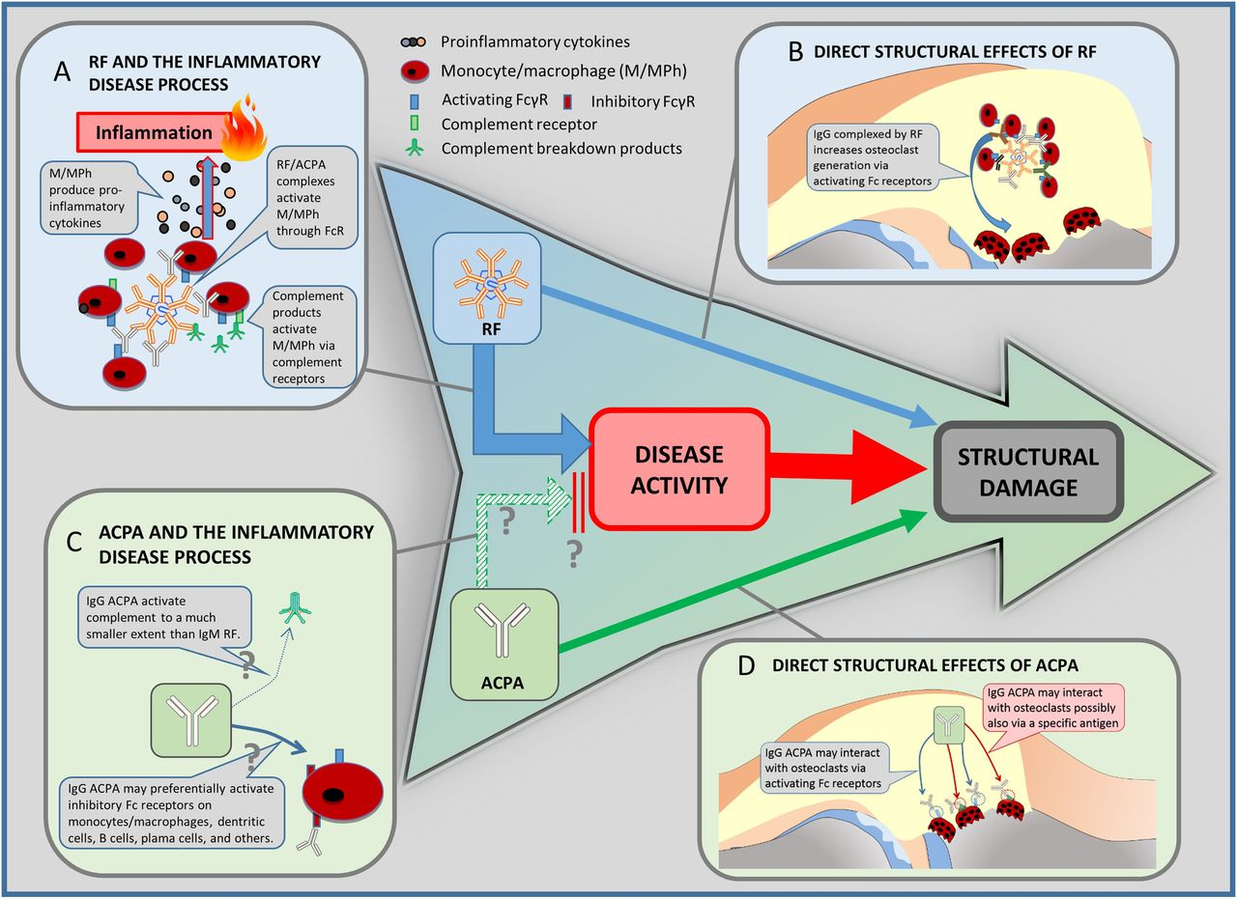
Clinical paradigms and pathogenetic explanations. The well-established clinical sequence of disease activity and structural damage is in the centre of the figure. At the same time, in clinical studies, rheumatoid factor (RF) has been shown to be linked to damage of rheumatoid arthritis via increasing disease activity, but also directly (blue arrows). Antibodies against citrullinated peptides/proteins (ACPA) is also associated with structural outcomes (solid green arrow). However, ACPA have not been shown to be associated with clinical disease activity. Vice versa, disease activity might even be lower in ACPA-positive patients (broken green arrow; see also, section ‘ACPA paradox’). Since this finding needs further confirmation, it is marked with a ‘?’. The panels around the central sequence are pathogenetic explanations for these clinical links; these links are quite well established for RF and the inflammatory disease processes (A), RF and direct effects on progression (B), as well as ACPA and its direct links to progression (D). They are hypothetical for the (paradoxic) link between APCA and disease activity (C). For details on the links and references see respective sections in the text.

Slide 14
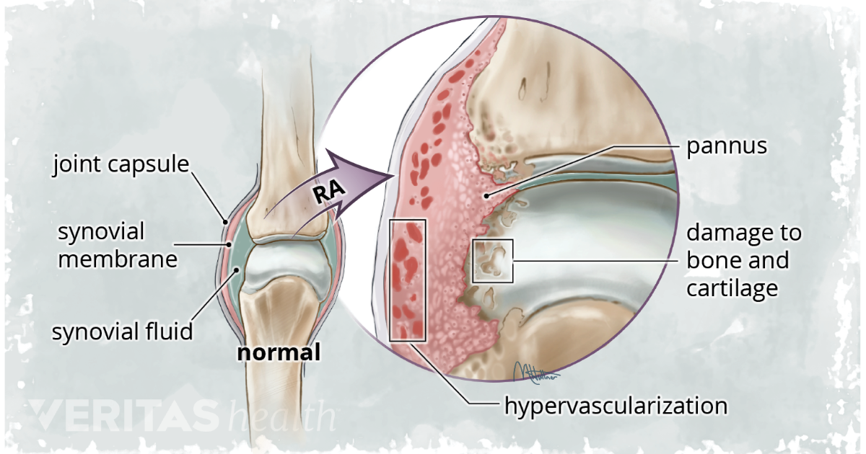
https://www.arthritis-health.com/types/general/inflammatory-arthritis

Slide 15
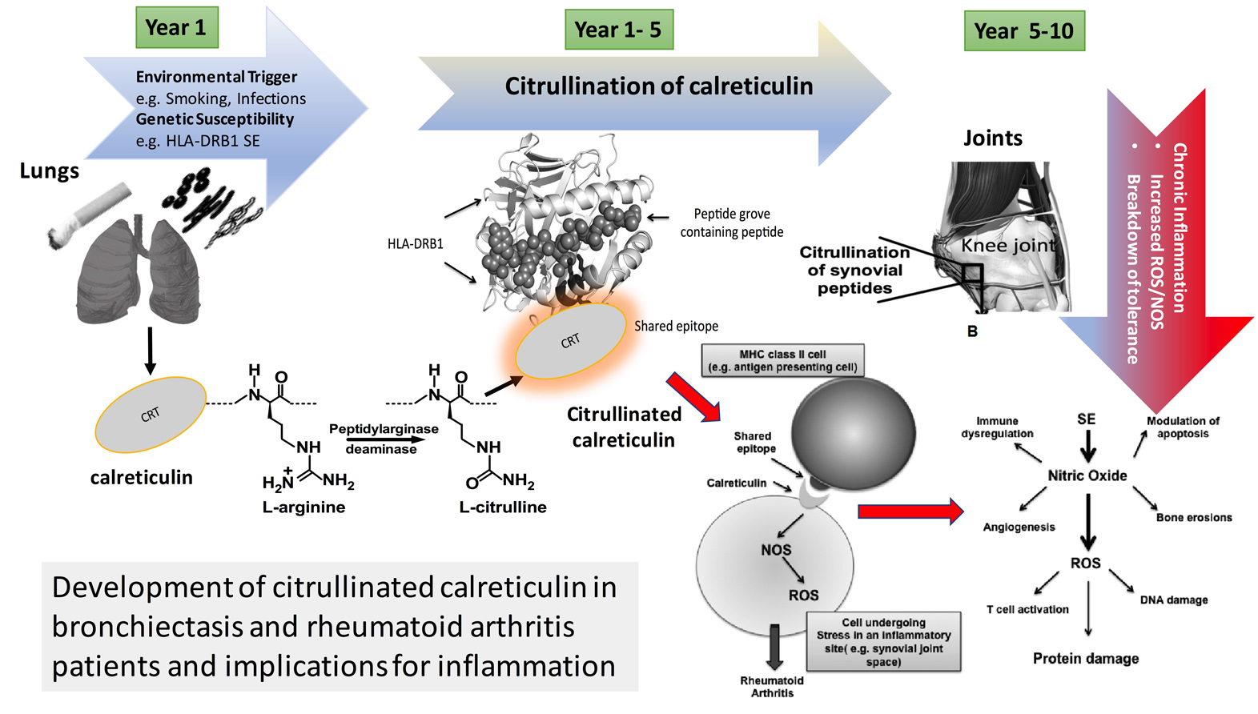
Lung infections and the origins of rheumatoid arthritis
HLA-DRB1
Shared Epitope
携带 HLA-DRB1 突变的 + 冷漠严酷的母亲的情况下 ==> 表现出暴力行为

Slide 16
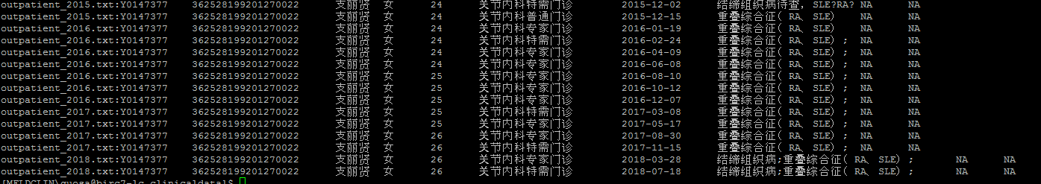
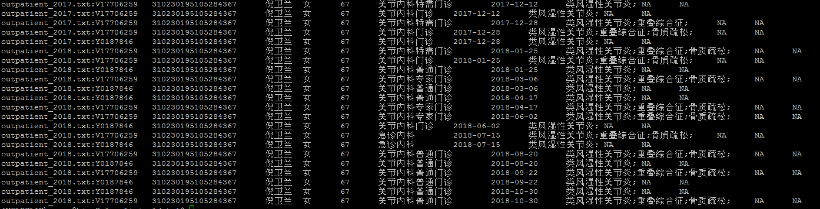

Slide 17
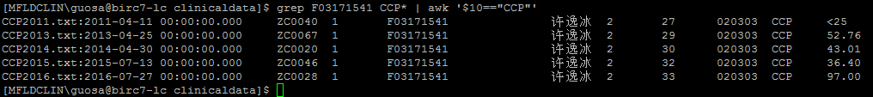

Slide 18
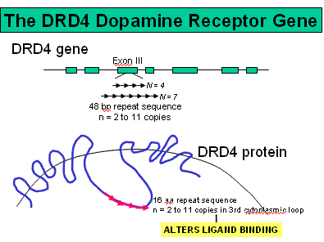
Dopamine DRD4 receptor polymorphism and attention deficit hyperactivity disorder
DRD4 基因也叫多动症基因
携带 DRD4 突变的孩子 + 冷漠严酷的母亲的情况下 ==> 表现出暴力行为
Notes:
2004年，荷兰莱登大学的学者 MARIAN Bakermans-Kranenburg 扛着摄像机进驻到2000多个暴躁逆反的1-3岁幼儿的家中。这些熊孩子经常哭闹大叫，喜欢发脾气丢东西，不听父母的话。许多研究发现，在这个年龄段展现出这类行为的孩子往往日后学业不佳，并很可能发展出反社会倾向。而这种行为，和一个名为 DRD4 的基因有关。DRD4 基因也叫多动症基因，它的某个突变会让携带者成为多动症高风险人群，表现如上所述。但是，Bakermans-Kranenburg 在对这些家庭的儿童和父母的基因以及攻击性进行研究后发现，只有在遇上冷漠严酷的母亲的情况下，携带 DRD4 突变的孩子才会表现出暴力行为。光有冷漠的母亲，或光携带 DRD4 突变本身不会让一个孩子变得更有攻击性。更重要的是，DRD4 这个基因的突变不仅和多动症和霸凌行为有关，也和热爱探索和寻求奖赏的个性有关。把携带高风险 DRD4 突变的孩子交给一个善解人意的母亲，结果会不会不同？为了证实这个设想，在8个月的时间里，Bakermans-Kranenburg 造访了其中120户家庭，拍下了他们的育儿片段，然后把这些片段剪辑成育儿培训视频，供其他母亲学习如何识别孩子的情绪。比如，一些熊孩子在母亲给他们念书之后，表现得很愉快，这样的片段让其他母亲知道，给孩子念书可以缓解他们的敌对行为。Bakermans-Kranenburg 把157个有暴力行为的1-3岁儿童的家庭分成2组，其中一组的母亲观看了这些共情指导视频；另一组没有接受任何指导。在这样干预了18个月后，2组原本相似的家庭出现了分化。那些携带多动症基因突变，并且母亲接受了共情培训的孩子的攻击性下降了27%，下降程度超过那些低风险型基因突变，或者母亲并没有接受育儿指导的儿童。
在另一项研究中，以色列希伯来大学的心理学家 Ariel Knafo 也对携带高风险 DRD4 突变的3岁儿童进行了研究。在实验里，研究者假装不小心撞到了膝盖，还弄丢了娃娃，借此来看看这些3岁的孩子会不会过来帮忙或者安慰自己。结果，那些携带多动症基因突变，并且母亲冷漠的儿童对“痛苦”的研究者无动于衷；意外的是，那些最乐于助人的孩子也携带这个突变，不过他们有热心体贴的母亲。

Slide 19
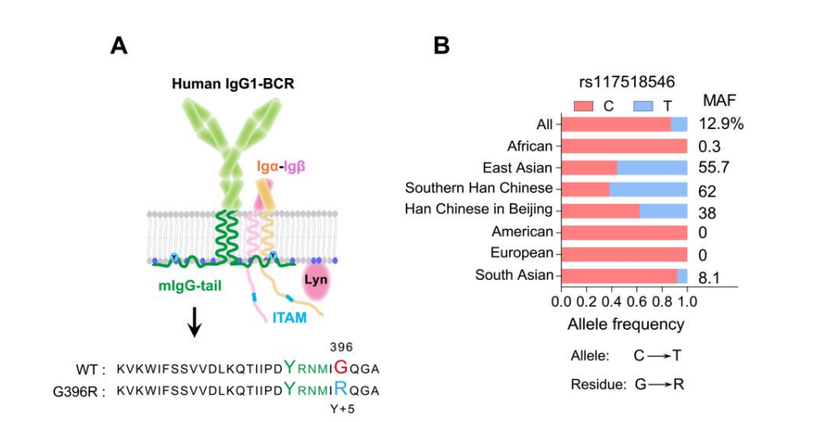
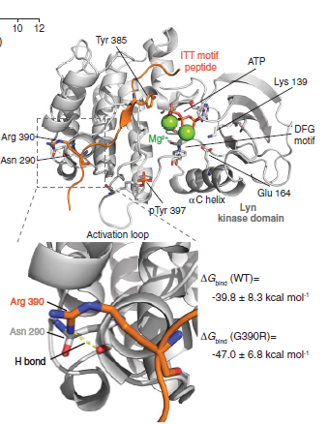
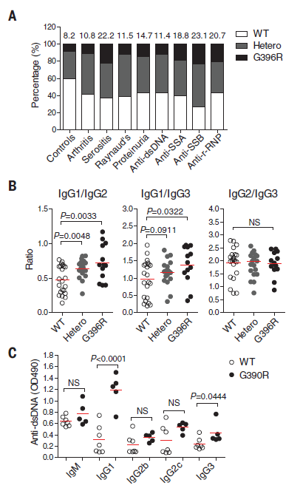
An autoimmune disease variant of IgG1 modulates B cell activation and differentiation
rs117518546 ( Glycine-> Arginine)
Chen, X. et al. An autoimmune disease variant of IgG1 modulates B cell activation and differentiation. Science 362, 700-705 (2018).

